Slide 1
Music Memory Lane
MWg8

Slide 2
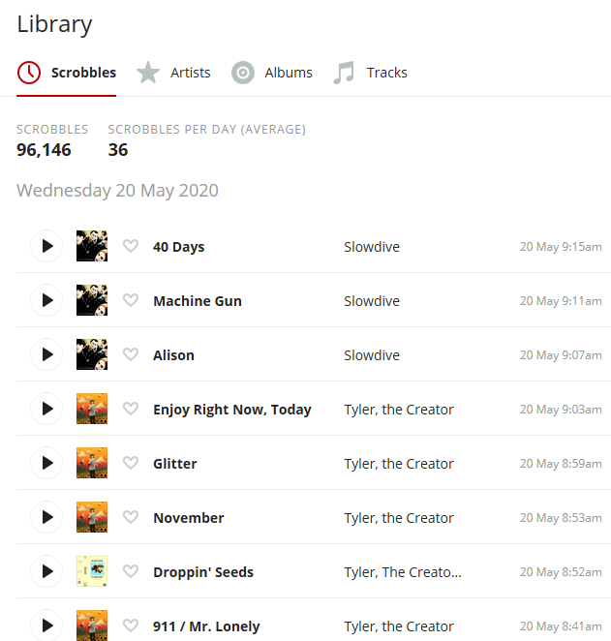
Context – Last FM
Last FM is a music tracking website, you configure it to whatever player of your choice. Every time you play one song it’s sent to a database online.
Includes, a timestamp, title, artist, album.
Notes:
From there you can see trends in the music you listen to. Mine are tracked till 2013

Slide 3
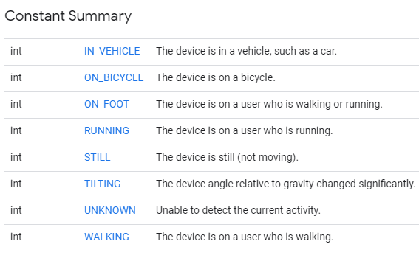
Context 2 – Google Maps
Google maps location history is tracked by default on most Android devices.
I’ve owned an android device has been tracking since 2014.
The format of location history has timestamp, location and activity
Possible activities on the right.

Slide 4
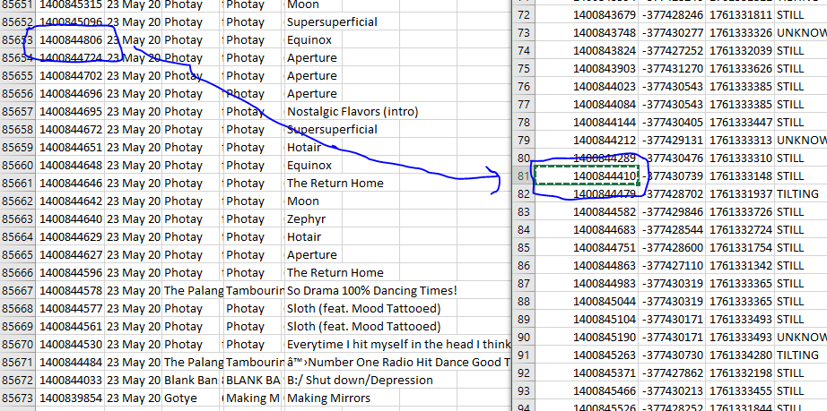
Combining the two datasets
It’s not a relationship of one to one for song listen -> maps data location.
I had to accept a window of tolerance for matching the data.

Slide 5
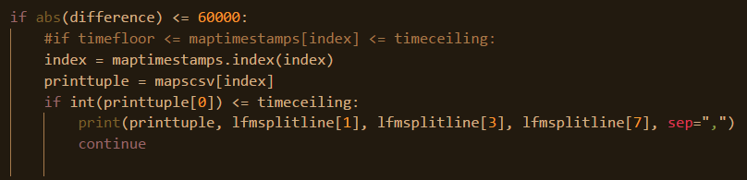
Combining the two datasets
The timestamp value is the standard linux timestamp of seconds since 1 Jan 1970
https://en.wikipedia.org/wiki/Unix_time
Using Python I joined the two datasets on the timestamp value, and accepted a difference of 60000

Slide 6
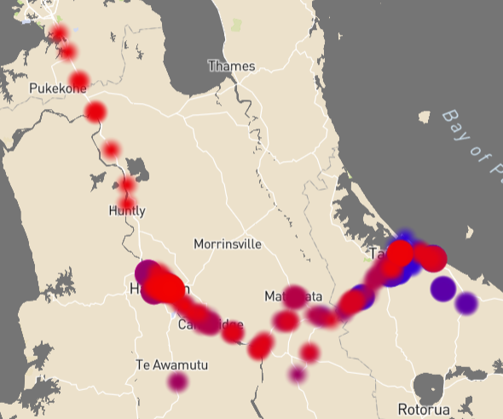
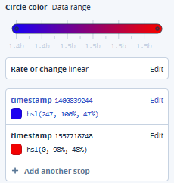
Displaying the combined data
I decided to use a heatmap layer on Google Maps. With the help of Mapbox.com
As you can see I’ve spent the majority of the last 6 years in Tauranga and Hamilton
Red = more recent.
Blue = ~5 years ago.

Slide 7
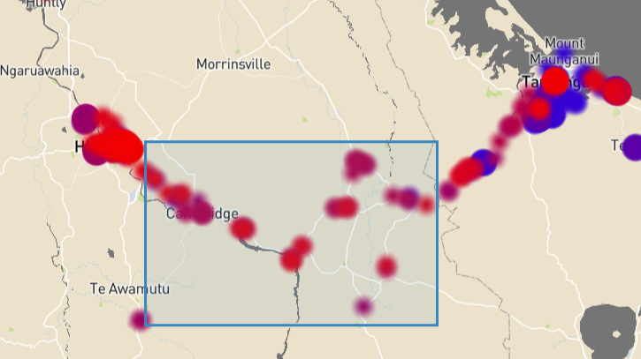
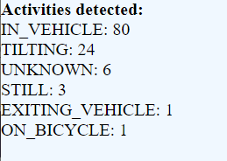
Fun finds
You can see in the space between Tauranga and Hamilton, I was mostly in a car. Makes sense.

Slide 8
Fun finds
You can see in the space between Tauranga and Hamilton, I was mostly in a car. Makes sense.

Slide 9
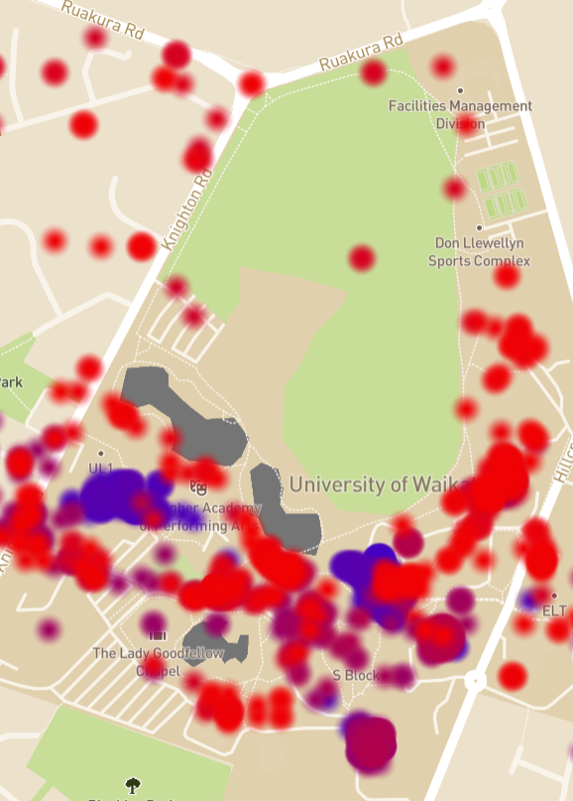
Fun finds 2
Benefits of coloured data points.
Blue = older.
Red = more recent.
On campus, the blue areas you can see I was in Student Village at that time. Also a lot of time was spent at the library.
After my degree I landed a job here for Waikato and now spend most of my time in TC block and all over. Shown in red.
Closer to the bottom you can see R block. Which is purple, meaning 2016-2018.

Slide 10
Thanks

